Slide 1



SOFTWARE DEVELOPMENT PROFESSIONAL PROGRAM
Containers, Tables & Lists

Slide 2





Containers, Tables & Lists
Learning Objectives
Use an unordered list to create a simple navigation bar.
Display data in a table.
Describe the difference between inline and block elements.

Slide 3
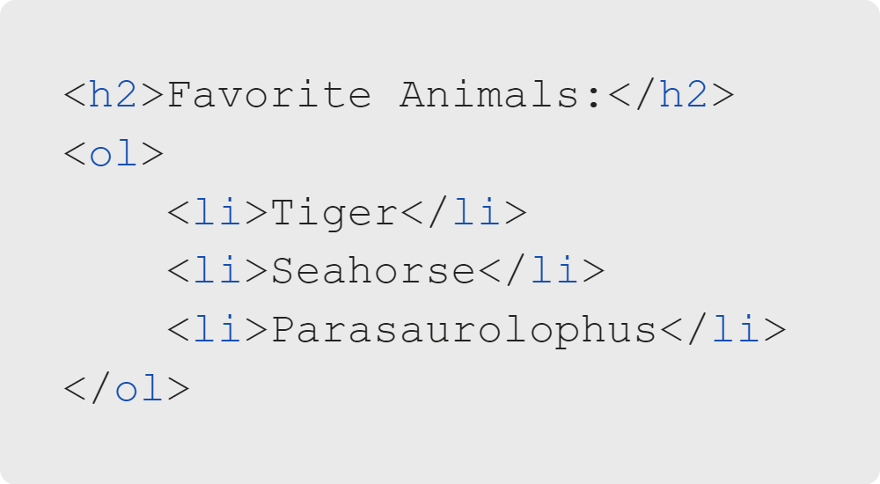
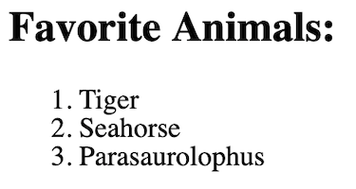
Containers, Tables & Lists
Review: HTML Lists
Ordered lists (ol): Numbered
Unordered lists (ul): Bulleted
Both types contain list items (li).

Slide 4

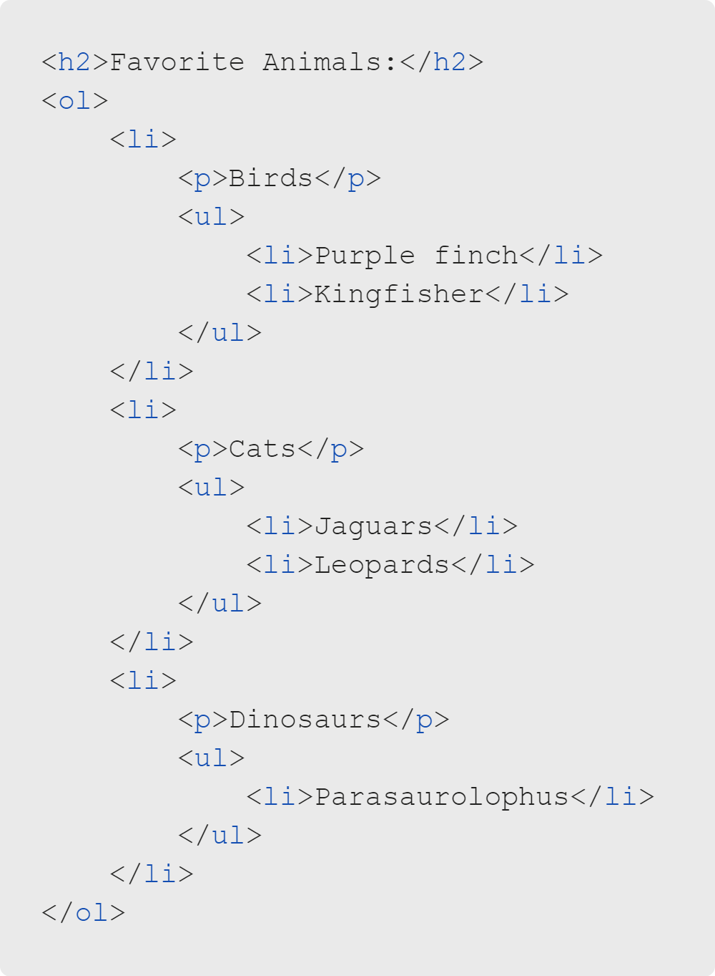
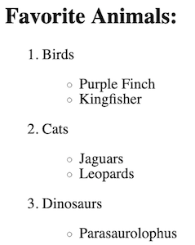
Containers, Tables & Lists
Review: Ordered & Unordered Lists
Notes:
Fun Fact: Later, we will learn how to use CSS to change the bullet style. There are many
different built-in options, such as roman numerals, alphabetical, squares, and even Japanese!
W3Schools has a list-style-type example you can check out if you have time:
https://www.w3schools.com/cssref/playit.asp?filename=playcss_ol_list-style-type&preval=cjk-ideographic
<< Refer to LC exercise 1: Lists >>

Slide 5

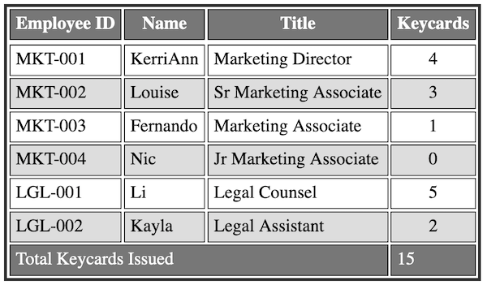
Containers, Tables & Lists
Tables display data (they are NOT for formatting!).
Notes:
Note: Styling has been added to this example. By default, there are no colors or borders.
If a learner asks why tables are bad for things like navbars, you can cite this article:
https://www.thoughtco.com/dont-use-tables-for-layout-3468941
Highlights include: tables are not accessibile, tables are bad for SEO, and tables are inflexible.

Slide 6
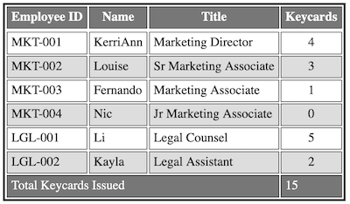
Containers, Tables & Lists
Table Sections
Tables have three sections:
Header (thead)
Body (tbody)
Footer (tfoot)

Slide 7
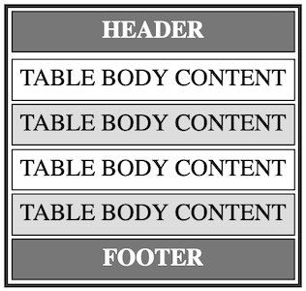
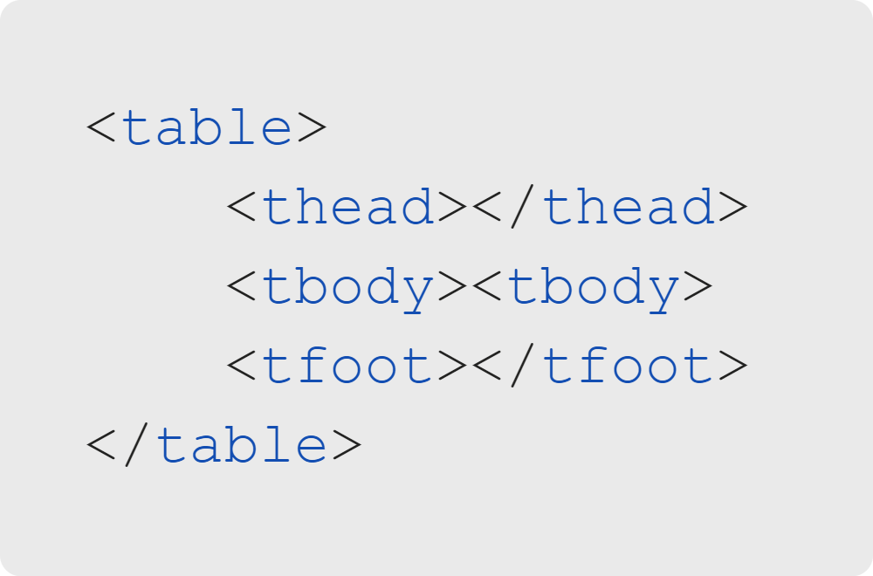
Containers, Tables & Lists
Table Sections
Notes:
<< Refer to LC exercise 2: Table Layouts >>

Slide 8
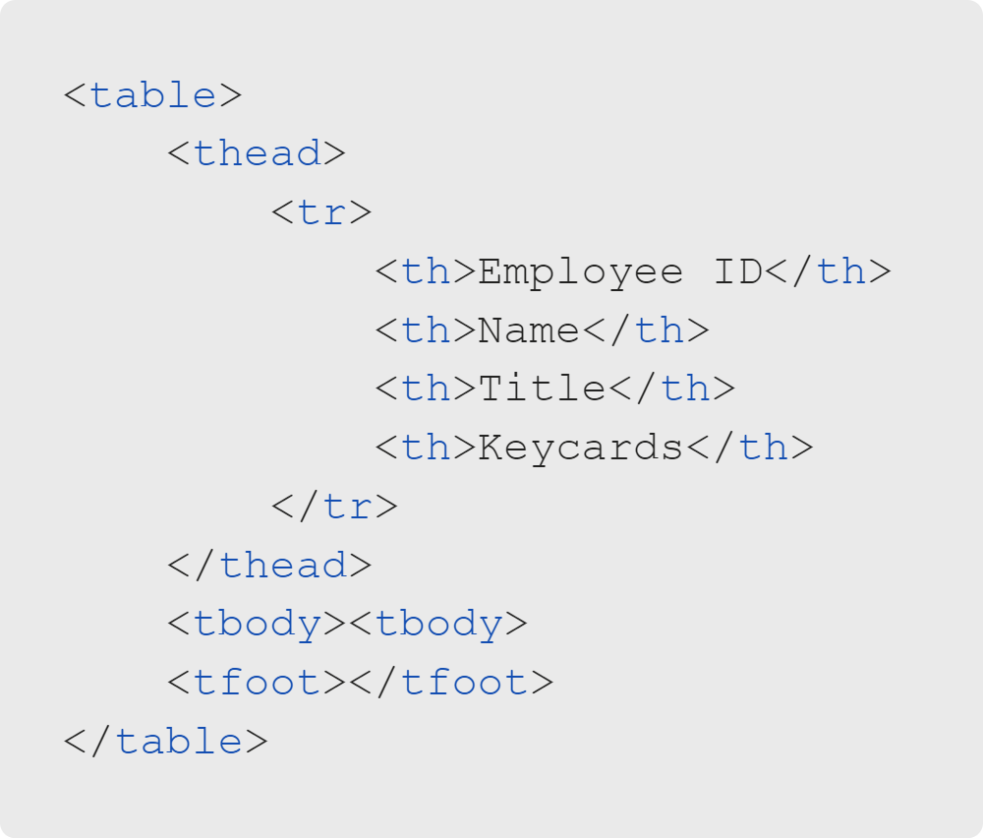

Containers, Tables & Lists
Table Header
tr tags define the rows (horizontal).
th tags define the column headers.
Notes:
This is what an unstyled table header looks like. The "th" tag is bolded but has little additional styling.

Slide 9
Containers, Tables & Lists
Table Header
th tags are bolded and centered.
We cannot create other styles without CSS.
Notes:
<< Refer to LC exercise 3: Table Headers >>

Slide 10
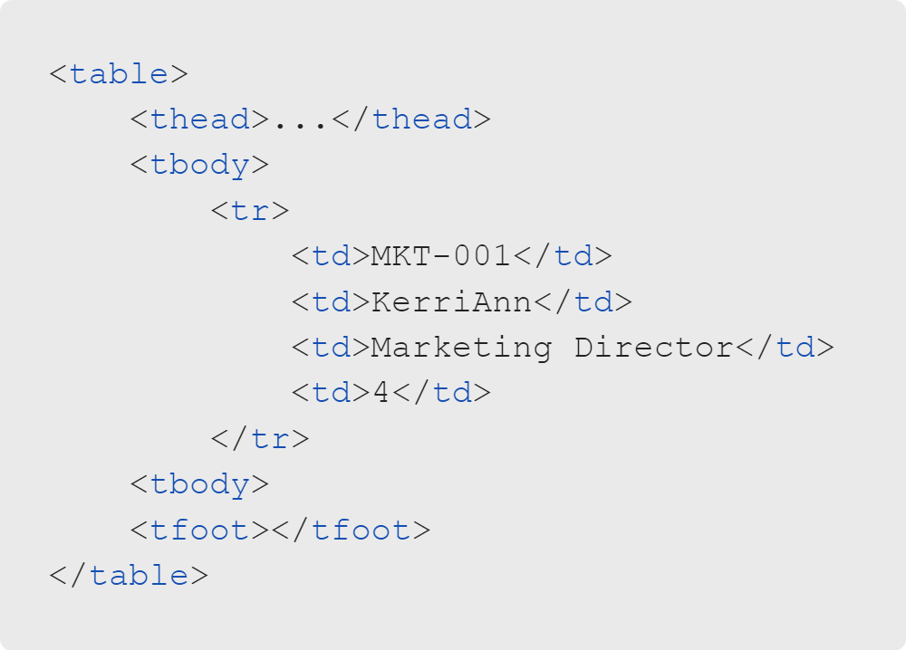

Containers, Tables & Lists
Table Body
tr tags define each row.
td tags define each cell.

Slide 11

Containers, Tables & Lists
Table Styling
Notice the lack of borders and styling.
For that, we need some CSS.

Slide 12
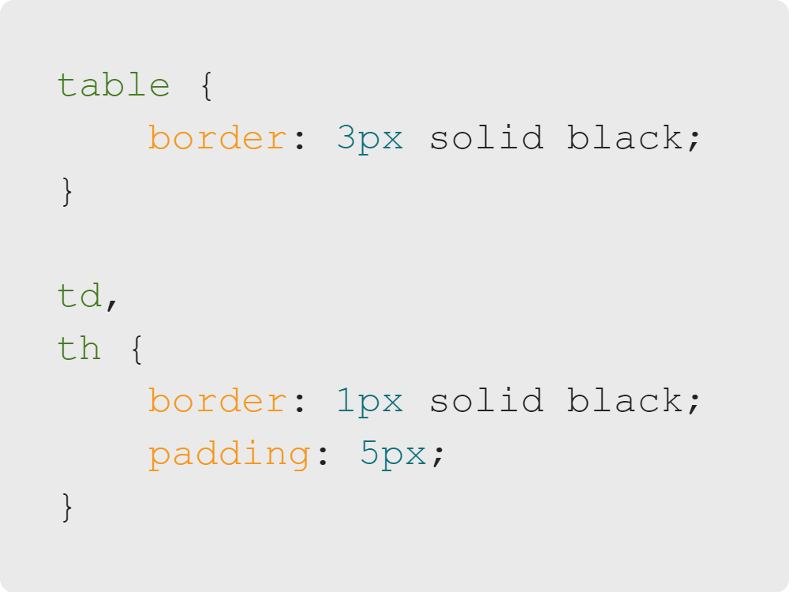

Containers, Tables & Lists
Table Styling
Borders show the edges.
Padding can help space things out.

Slide 13
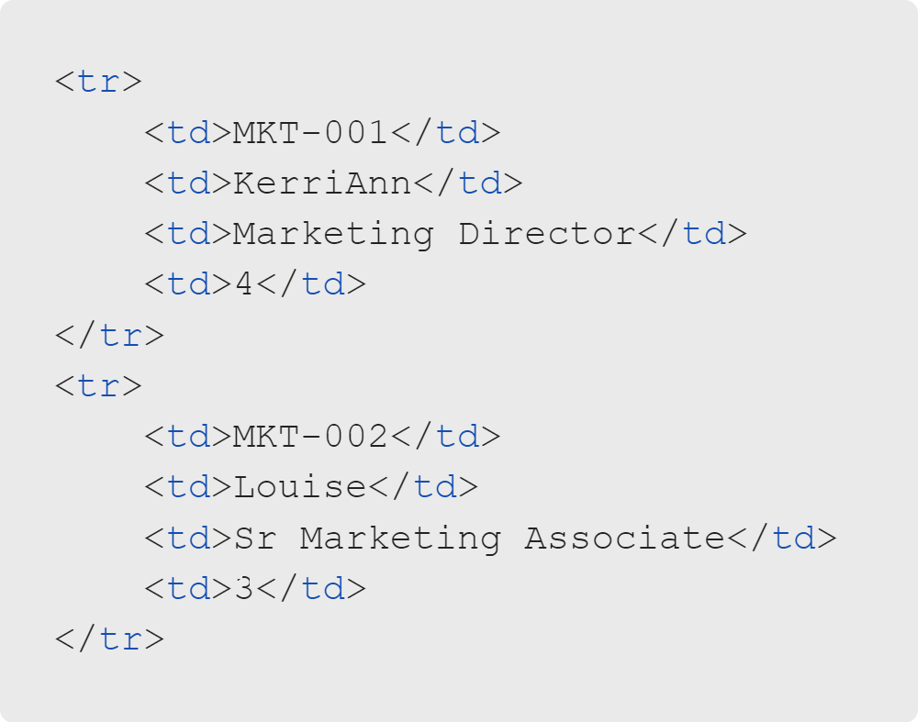
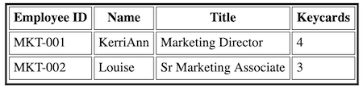
Containers, Tables & Lists
Table Body
Each tr defines a new row.
Notes:
<< Refer to LC exercise 4: Table Content >>

Slide 14
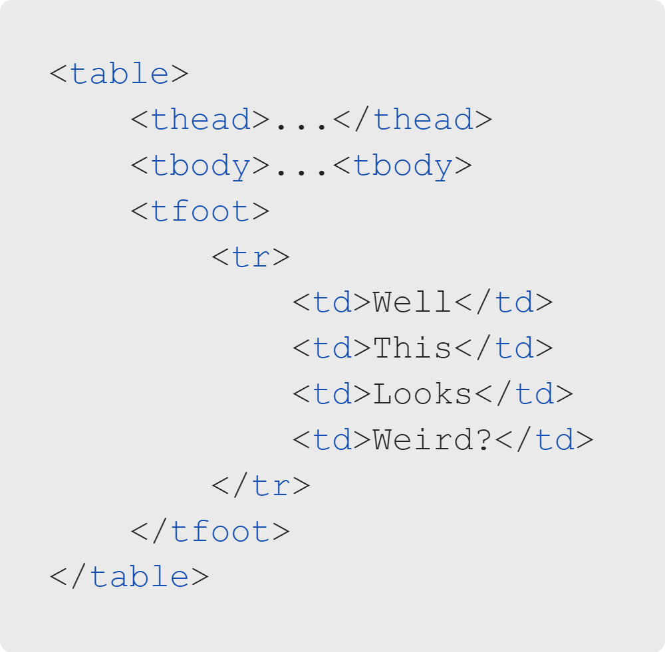
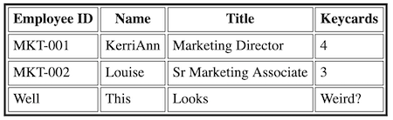
Containers, Tables & Lists
Table Footer
Table footers need tr and td tags!
However, it looks kind of weird as four cells.
Notes:
Footers are often used for summaries and footnotes.

Slide 15
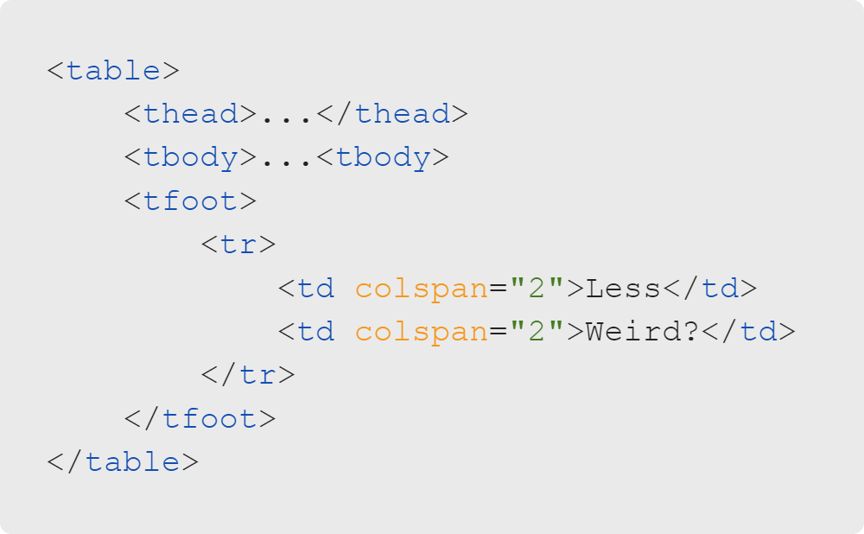
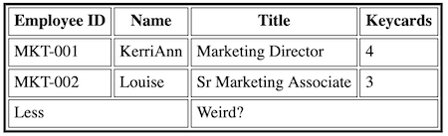
Containers, Tables & Lists
The Colspan Attribute
The colspan property merges cells.
Notes:
The number of td columns should match the number in thead and tbody (four).
However, we can use the colspan attribute when we want to merge multiple cells.

Slide 16
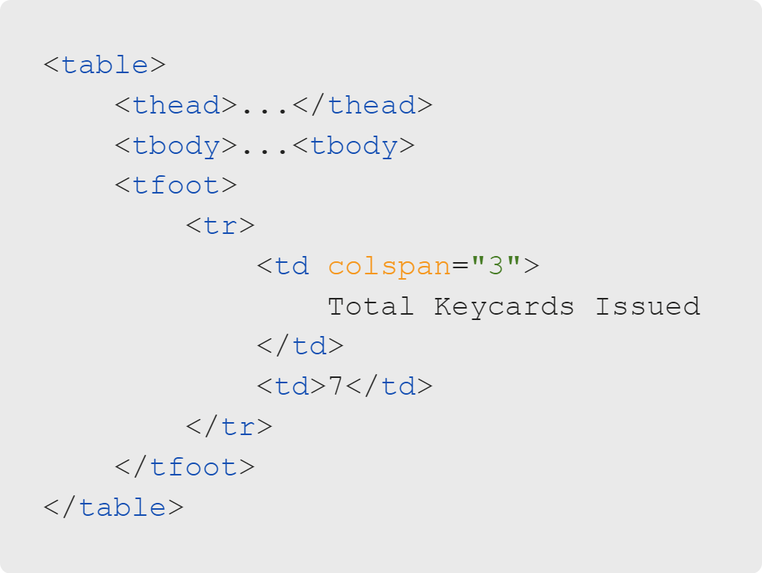
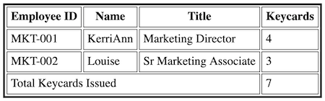
Containers, Tables & Lists
Formatted Footer
Sum the number of keycards issued.
Ensure the total matches the number of columns!
Default colspan value = "1"
Notes:
<< Refer to LC exercise 5: Table Footers >>

Slide 17

Containers, Tables & Lists
Quiz: Multiple Choice
Which of the following do you think are often used to create navbars on websites?
A. Tables
B. Lists

Slide 18
Containers, Tables & Lists
Quiz: Multiple Choice Answers
🚫 A. Tables
Which of the following do you think are often used to create navbars on websites?
✅ B. Lists
It's tempting to use tables for formatting.
Best practice: Leave the styling to CSS!
Notes:
Back in the bad old days of web dev, we overused tables for formatting our pages. It wasn't the best
idea, because tables are inflexible, not accessible, and bad for SEO. Now we have many ways to style
with CSS that allow us to control appearance while maintaining accessibility!
Again, here is an article going into even more reasons why tables for navs are not advisable, followed by some
quotes from the article: https://www.thoughtco.com/dont-use-tables-for-layout-3468941
The HTML4 specification states: "Tables should not be used purely as a means to lay out document content
as this may present problems when rendering to non-visual media."
The HTML5 specification states: "Tables should not be used as layout aids." This is because tables for
layout are difficult for screen readers to differentiate, as previously mentioned.

Slide 19
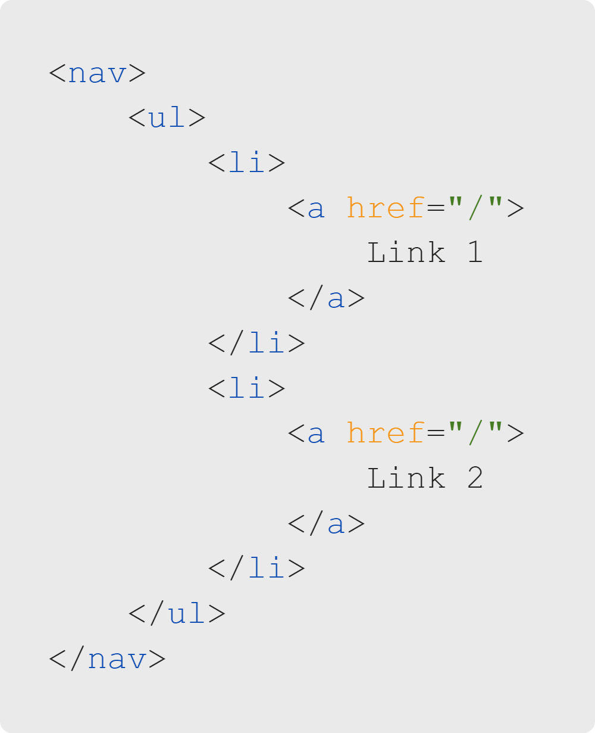
Containers, Tables & Lists
Navbars
Navbars often use lists in nav elements.
The nav container acts like a div, but is more descriptive.

Slide 20
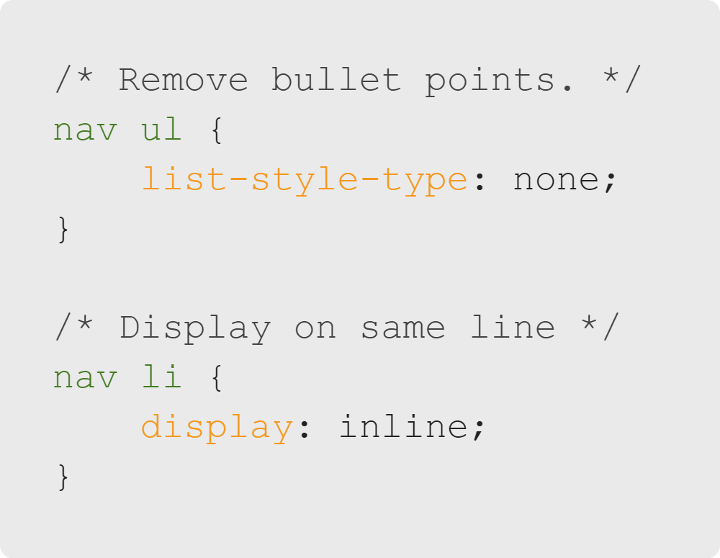
Containers, Tables & Lists
Navbars
Default styles like bullet points are removed.
New styles are added.

Slide 21
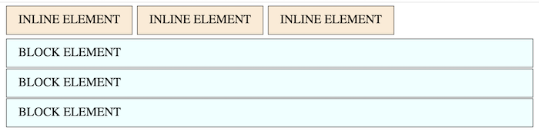
Containers, Tables & Lists
Introducing Display: Block vs. Inline
A span is an inline element.
A div is a block element.
Notes:
<< Refer to LC exercise 6: Inline vs. Block >>

Slide 22

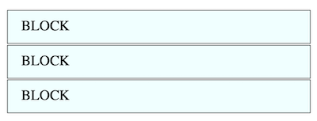
Containers, Tables & Lists
Block vs. Inline
Always starts on a new line
Takes up the available width of the parent
Respects width/height/padding/margin

Slide 23


Containers, Tables & Lists
Block vs. Inline
Doesn't start on a new line
Doesn't respect top and bottom padding/margin
Doesn't respect width and height

Slide 24
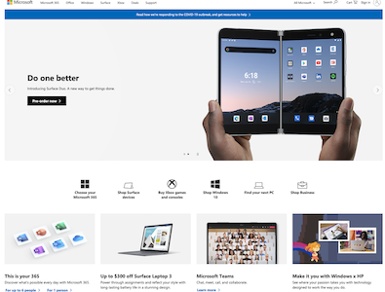
Containers, Tables & Lists
Page Layouts
Consider Microsoft's website layout.
Microsoft.com

Slide 25
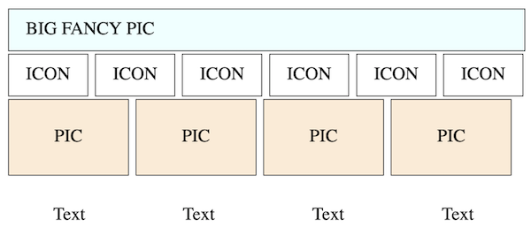
Containers, Tables & Lists
Page Layouts
It looks kind of like this:

Slide 26
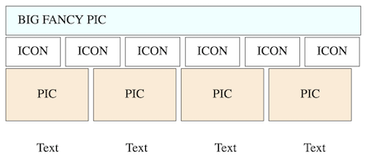
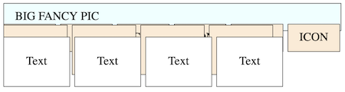
Containers, Tables & Lists
What Happened?
Expected this:
Got this:
Notes:
Remember how inline elements don't respect padding and margins?
Notice how the content is taking up space but the rest of the box is not.

Slide 27

Containers, Tables & Lists
Quiz: Multiple Choice
A. Used block elements when inline elements were needed
What happened with that layout?
B. Used inline elements when block elements were needed
C. We need something besides inline and block.
Notes:
"A" would not work because every box would be on a separate line.
"B" does not work because everything is overlapping (this is what we're observing).
So, we need something else!

Slide 28
Containers, Tables & Lists
Quiz: Multiple Choice Answers
🚫 Used block elements when inline elements were needed
What happened with that layout?
🚫 Used inline elements when block elements were needed
✅ We need something besides inline and block.

Slide 29
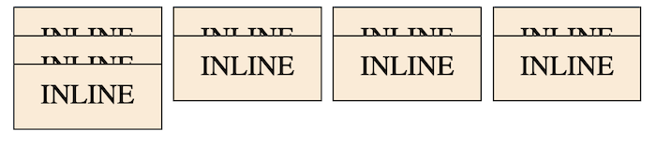
Containers, Tables & Lists
Page Layouts
Inline doesn't respect:
Width and height
Top and bottom margins

Slide 30
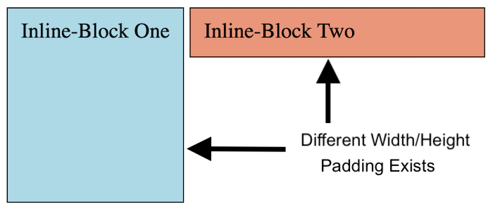
Containers, Tables & Lists
Introducing Inline-Block

Slide 31

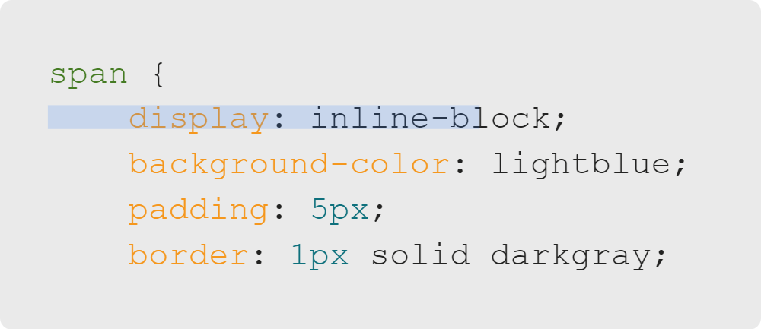
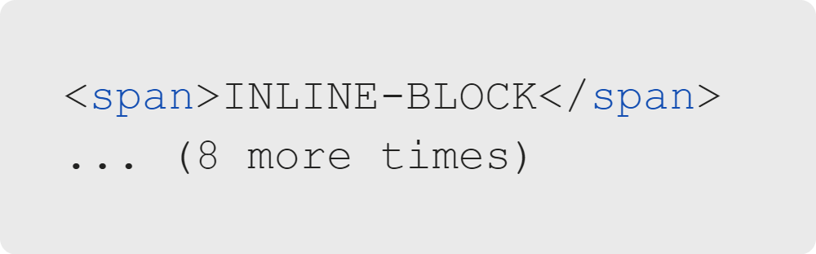
Containers, Tables & Lists
Inline-Block
style.css
index.html

Slide 32
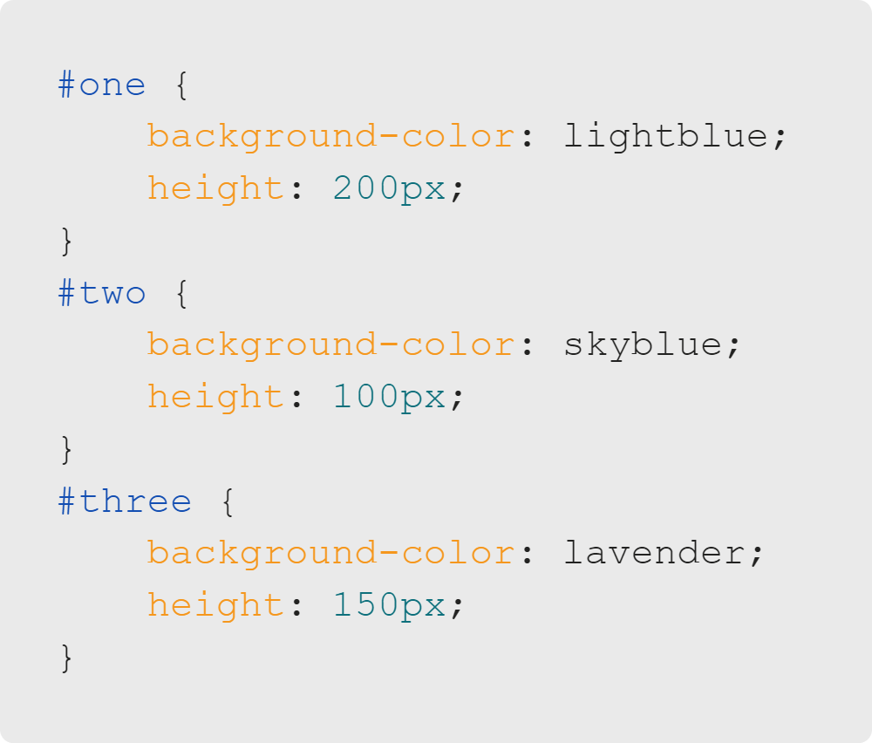
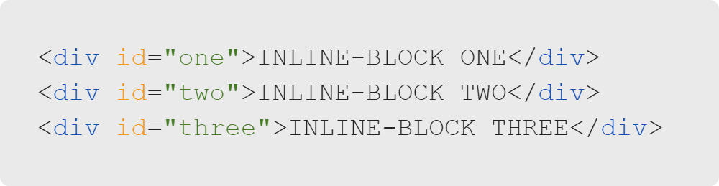
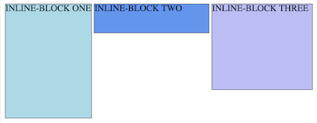
Containers, Tables & Lists
Inline-Block
Notes:
We can size individual elements with inline-block, because they follow the box model.
The unique "id" attribute on each div allows individual styles in the CSS.

Slide 33

Containers, Tables & Lists
Activity Intro
Let's make our own navbars.
You may use your portfolio site!

